Slide 1
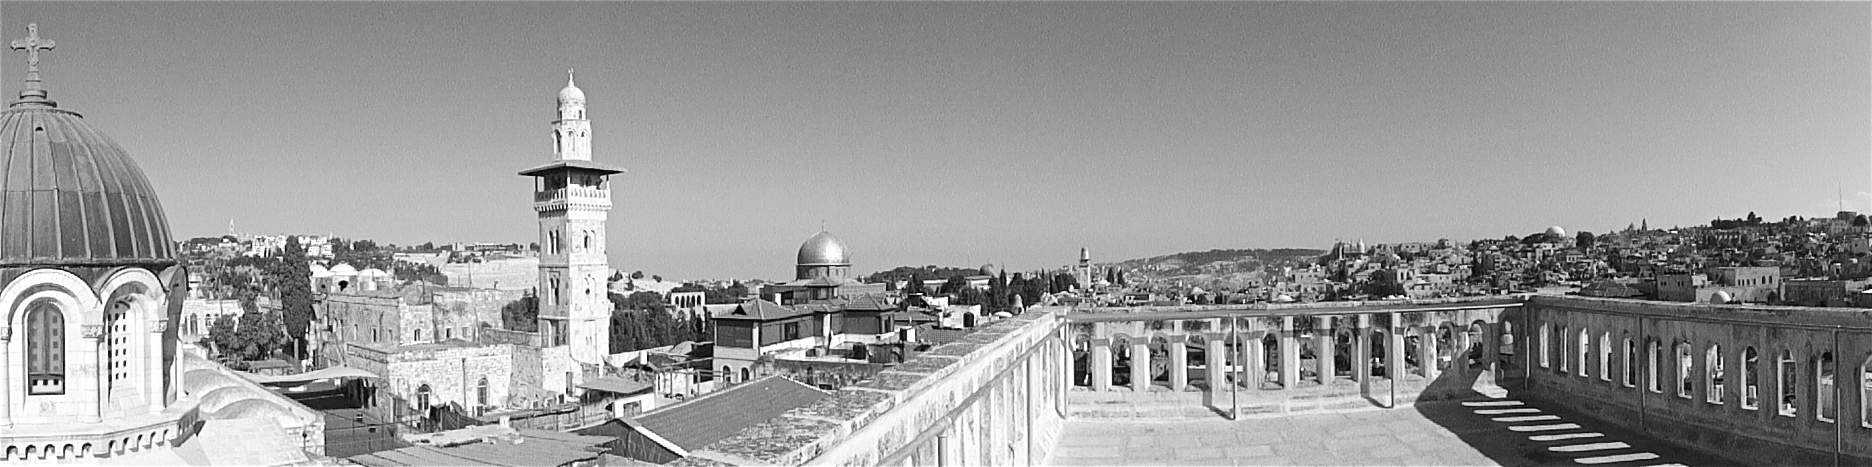
Perspectives on Friendship Across Religions
Awet Andemicael Meeting of the Board of World Religious Leaders
Global Retreat Centre Elijah Interfaith Institute
Oxford, UK 18 March 2011

Slide 2
Interviews with Elijah Board Members
Swami Atmapriyananda | Rabbi Michael Melchior
Shrivatsa Goswami | Guruji Sri Rishi Prabhakarji
Rabbi Menachem Hacohen | Rabbi David Rosen
Maulana Wahiduddin Khan | Ven. Prof. Jinwol Sunim
Bishop Lennart Koskinen | Dr. Karma Lekshe Tsomo
Rabbi Richard Marker

Slide 3
Interfaith Friendship: Issues to Consider
What do we mean by “friendship”? What is special about interfaith friendship?
Situating interfaith friendship contexually
Risks and Challenges
Benefits and Opportunities
Practical Applications

Slide 4
What do we mean by “friendship”?
Wide range of relationships fall under this category
Degrees of intensity and duration
Degrees and types of interaction
Degrees of depth
Character of relationships: Personal, Professional, Etc.
Other factors

Slide 5
What is special about interfaith friendships?
Factors common to other kinds of friendship
cultural and personal attitudes toward friendship in general
lifestyle and vocational challenges to maintaining friendships
benefits and challenges related to any friendship that crosses boundaries (geographic, ethnic, class, gender, etc.)

Slide 6
Situating Interfaith Friendship Contexutally
Historical context: history of relations between the relevant groups
Contemporary cultural/social/economic context: interaction of other factors besides religion
Personal context: biography, personality, spirituality, sociability, etc.

Slide 7
Risks and Challenges
Risks
Potential to misunderstand or be misunderstood (e.g., taking a friend’s criticism as resulting from religious bias)
Assumptions about commonality (e.g., misconception that a notion of “God” is common to all religions)
Challenges
Responses of Others (family and community, colleagues, other co-religionists)
Concerns about Proselytizing/Conversion as a barrier
Practical Challenges (e.g., Food)

Slide 8

Challenges: Proselytization as Barrier to Friendship
“I opened with a gambit that had worked so well with all the others: […] ‘the things that bring us together are so much more important than the things that keep us apart.’
“And to my surprise, he says to me, ‘Well, Rabbi, I have to tell you the truth, I cannot agree with you, because the most important thing in my life keeps us apart: my belief in Jesus as my personal savior. You do not share that, Rabbi, therefore to tell you the truth, Rabbi, you are going to burn in Hell and I cannot meet with you, unless it is to fulfill my duty as a good Christian to save you.’”
Rabbi David Rosen

Slide 9
Challenges of Interfaith Friendship: Proselytization (cont.)
I said to him, ‘Well, Doemeni, thank you very much for your honesty. I still would like you to come along to our meetings. In fact, you should now feel obligated because I am giving you the opportunity to convert me. And I want to understand you and how you think and I think it is important that you understand me, so it is the beginning of understanding’.
So he came along to our meetings and he became less doctrinaire and involved others.
Rabbi David Rosen

Slide 10
Challenges of Interfaith Friendship: Proselytization (cont.)
“It was really a very good lesson for me, that generally speaking, one should avoid getting on one’s high horse – and should try to be more pragmatic. Yes, there are sometimes there are principles where one shouldn’t budge, but if it is possible to be flexible, then one should try one’s best to find the way to engage the other, to dialogue.”
Rabbi David Rosen

Slide 11
Benefits and Opportunities
Personal Benefits
Spiritual growth
Overturning our own stereotypes
Common bonds across religious lines
Social/Communal Opportunities
maturing our ministries (how we speak of and preach about the religious other)
public witness to the possibility of interfaith peace and reconciliation
Enabling more effective dialogue and peacemaking
Improved communication and understanding
Peacemaking alliances and coalitions across religious lines
Foundation for interreligious social action

Slide 12

Common Bonds across Religions
“It is actually the liberality and lack of fanaticism that matters rather than the religious tradition one belongs to. At the same time, I believe in being deeply rooted in one’s own tradition (in my case the Ramakrishna-Vivekananda tradition in Hinduism) while accepting and assimilating the best of other traditions.”
Swami Atmapriyandanda

Slide 13

Challenge and Opportunity: Interfaith Friendship as Witness
“The woman behind the counter took the order, then she said […],
‘How can you be friends?
You belong to different religions.’ […]
And I said, ‘Well, you know, we love
each other!
And we’ve been friends for years.’ […]
But, of course, we welcome opportunities to try to break [these barriers] down. We still go to that bubble tea stand; we give them a big smile and send lovingkindness to them. And I think maybe in a way it helps to break down some of people’s preconceptions about religious difference.”
Karma Lekshe Tsomo

Slide 14
Going Forward: Strengthening Friendships
Communication
“Translation” (Tsomo)
Communication beyond words (Sunim)
Negotiating through disagreements
love and friendship as foundation (Hacohen)
Managing difference (Khan)
Strategies for Dealing with External Opposition

Slide 15

Communication beyond Words
“I would like to bring to people’s attention beyond the word […] Without achieving the purposes of dialogue, simply talk is just a waste of time. [We need] less talk but [more] deep spiritual and intuitional communication. We simply say “love, love, love,” but the word “love” is not enough. Simply saying and hearing – sometimes it is a kind of rhetoric […], but their mind and their inner state is still here.”
Ven. Prof. Jinwol Sunim

Slide 16
Going Forward: Friendship and Dialogue/Peacemaking
Which must come first: Friendship or Interfaith Understanding?
Interfaith relationships do not become friendships without an openness to the other
Dialogue and peacemaking may rest on fragile foundations without a deep level of trust and commitment on all sides
Complex, often interrelated
Deep friendships often grow out of or in conjunction with interfaith dialogue
People who grow up in or are influenced by contexts of interfaith friendship may be more inclined toward dialogue
Difficult to parse, due to range of definitions of “friendship” and contexts of peacemaking

Slide 17
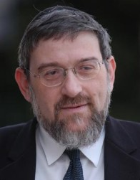
Friendship and Religious Peace
“Before we start finding solutions for the conflicts, […] let’s try to establish personal relationships […] Without religious peace between the big religions of the Middle East, we will not have a political peace, and without the personal trust and relationships and friendships, we will not have a religious peace. Because then we will be tied in with our fears, our stereotypes, our suspicions, and eventually, our hatreds. And it is very easy for this framework to become totalitarian”
Rabbi Michael Melchior

Slide 18

Mutuality of Friendship and Dialogue
“In my view it all starts with an open dialogue and sharing of knowledge and spiritual experiences, which can evolve into a deeper understanding and in some cases real friendship.“
Bishop Lennart Koskinen

Slide 19
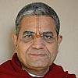
Interrelation of Friendship and Dialogue
“Commitment and participation in interfaith dialogue has led towards lifelong friendship and network[s]. Interfaith friendship and interfaith understanding are two facets of the same coin; one leads to other.”
Acharya Shri Shrivatsa Goswami

Slide 20
Going Forward: Friendship and Dialogue/Peacemaking
Role of Friendship in Interfaith Dialogue and Peacemaking
Friendship as Essential for Dialogue
For all interfaith dialogue
Primarily for “dialogue of life”
Friendship as Helpful, but not Necessary, for Dialogue
A certain level of trust is needed, but genuine friendship may not be necessary

Slide 21

Trust, Personal Connection, Friendship and Interfaith Understanding
“If one wants to be very practical, there are things that can happen if there is a level of personal trust, however you get there. […] There is a way in which having a personal friendship doesn’t guarantee amity, it doesn’t guarantee peace, but it opens the door for another level that’s not there [otherwise].
[…] Is there something that emerges from being able to say that there’s a warmth of personal connection? I do believe that. Is that indispensible? No. Does it enhance? Absolutely.”
Rabbi Richard Marker

Slide 22
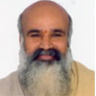
Challenges of Interfaith Friendship and Peacemaking
“All challenges can be toned down by love and friendship. Once you understand why the person is challenging, it is easy. You support his
cause and everything can be resolved. He will support your cause. First you must have the daring to support his cause.”
Guruji Sri Rishi Prabhakar

Slide 23

Foundation of Love
“I look at every human being, of any faith, as a person created in the image of God. […] Not always [does] my wife agrees with me and I agree with her. But we live together in love. And if people think that everyone has to think as the other one thinks, then there’s no relationship, there is no love, there is nothing. The main thing is to understand that the other one may think differently from you, your thoughts may be different from others, but in spite of all this, we have to live together.”
Rabbi Menachem Hacohen

Slide 24
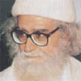
Managing Difference
“Once [Swami Vivekananda] was invited to his Christian friend. That Christian wanted to test him about his spirituality, so he arranged the meeting in a room where there was a table. On this table, there were the holy books of all religions. But the arrangement was the Gita was at the bottom and the Bible at the top, so it was a provocative situation for a Hindu. So they said, ‘Mr Swami, what is your comment about this scene?’ So Swami Vivekandanda said: ‘The foundation is very good.’ It was a great lesson for me. In every situation, you are able to convert negativity into positivity.”
Maulana Wahiduddin Khan

