Slide 1




Foeme’s Vision for the Lower Jordan River: Achievements and challenges to come
November 10, 2013
A commitment of Faith Conference
Supported by the Swedish International Development Cooperation Agency (SIDA) and the Osprey Foundation
www.foeme.org| info@foeme.org

Slide 2
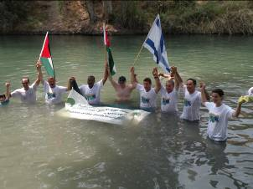
FoEME
FoEME celebrating 20 years of cross border environmental protection efforts.
FoEME strategy: ‘bottom-up’ community based programming and ‘top-down’ national level advocacy campaigns.

Slide 3
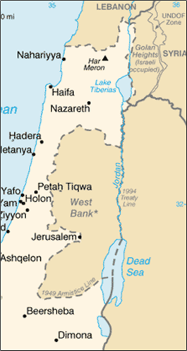
Transboundary River System
Lower part of Jordan River divides into three political areas:
Israeli:
Sea of Galilee to Yarmouk River
Jordanian-Israeli:
Yarmouk River to Bezek Stream
Palestinian-Jordanian:
Bezek Stream to Dead Sea

Slide 4
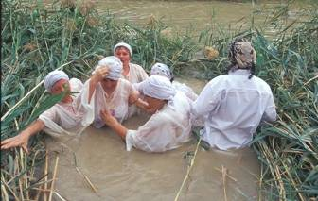
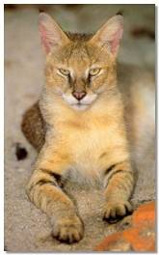
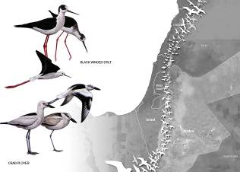

The Lower Jordan River
Rich in Cultural, Historical Heritage
Holy to Jews, Christians and Muslims
Unique Eco-System
Meeting point for flora and fauna of three continents
Migratory flyway for 500 million birds twice annually

Slide 5
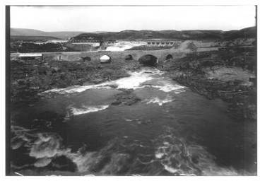
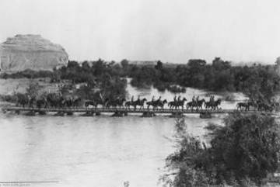
The Historical Lower Jordan River
Average annual flow of over 1.3 billion cubic meters including:
Upper Jordan: 540 mcm
Yarmouk: 480 mcm
Side Wadis: 280 mcm
Supported a wide variety of habitats/ rich biodiversity
Israel Electrical Company Archives

Slide 6
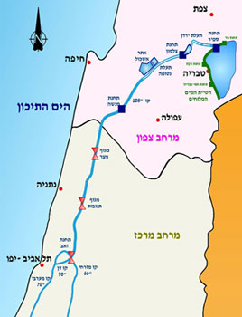
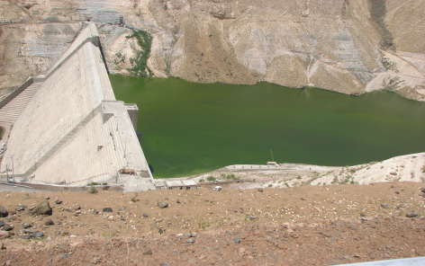
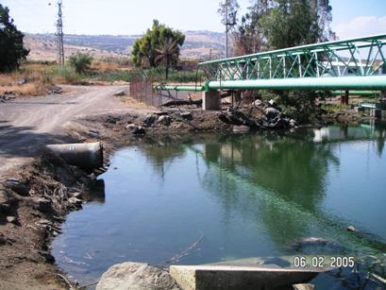
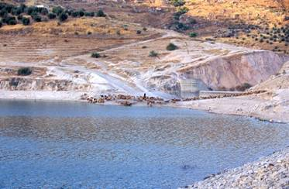

The Great Water Grab

Slide 7
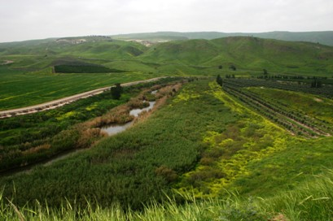
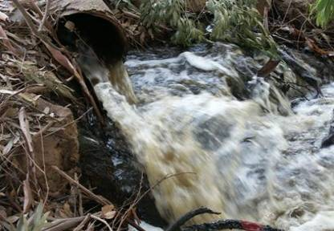
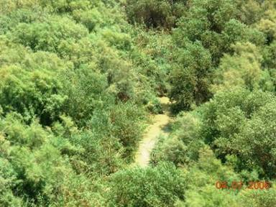
What is left for the Jordan?

Slide 8
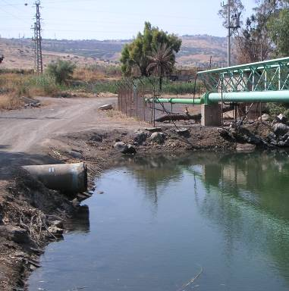
Lower Jordan River Rehabilitation Project Rationale
Over 96% of the Jordan River’s flow is diverted by Israel, Syria and Jordan.
Resulting in ecological devastation of the Jordan River system.
Loss of cultural heritage/ tourism revenue.

Slide 9
Target Groups and Beneficiaries
To create Political Will - Jordanian, Palestinian and Israeli government ministries and authorities, national level decision makers and local government leaders.
Benefit 600,000 Palestinian, Jordanian and Israeli residents of the Jordan Valley, International faith based communities, tourists etc.

Slide 10
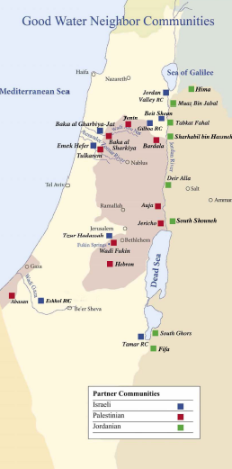
Strong Grassroots Foundation: Good Water Neighbors
Established in 2000
Now includes 28 communities; 15 in the Jordan River / Dead Sea Valley
Partner with municipalities, schools and community centers

Slide 11
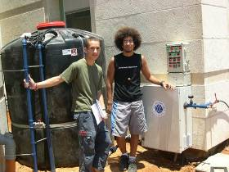
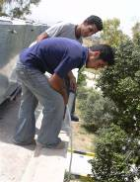
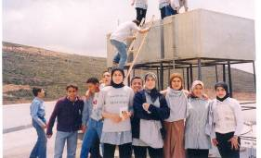
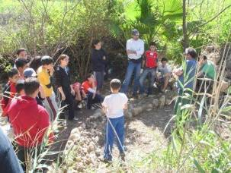
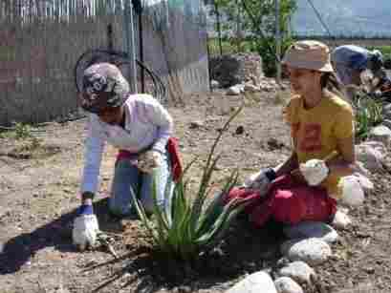
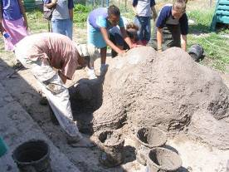
Youth Water Trustees

Slide 12
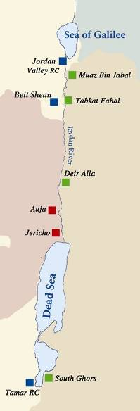
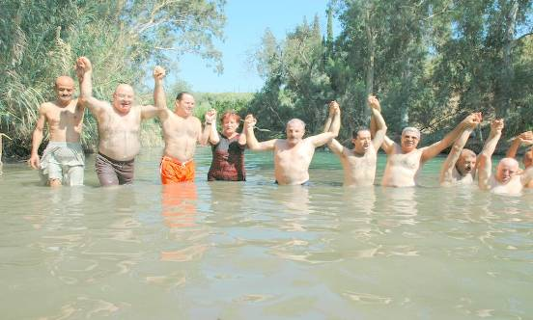
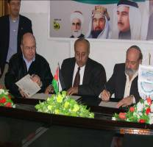
Municipal Leadership

Slide 13
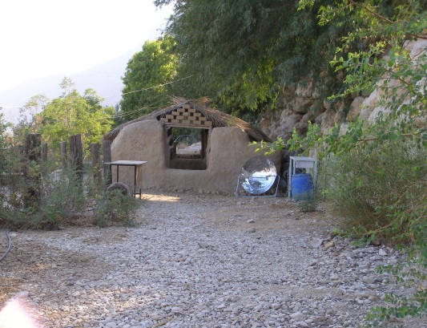
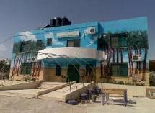
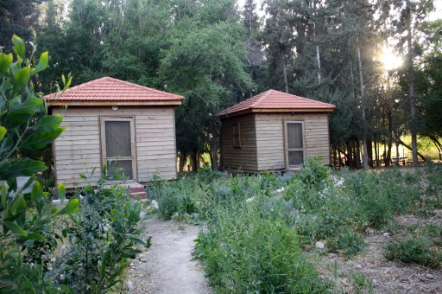
FoEME JV EcoParks
Ein Gedi EcoCenter,
Israel
Auja Environmental Education Center, Palestine
Sharhabil bin Hassneh EcoPark, Jordan

Slide 14
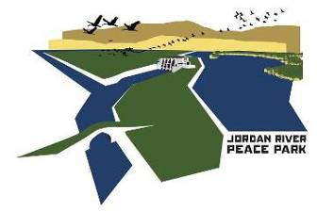
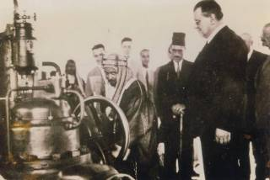
Advancing Transboundary Jordan River Peace Park
Draft Studies, Plans & Designs prepared
Israel Min of Regional Coop Invests in Northern Gate
Jordanian National Committee Est.
Tour Operators List Site
Working on Establishing the Bakoura as a Jordanian National Park

Slide 15
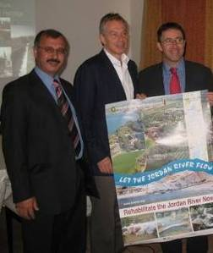
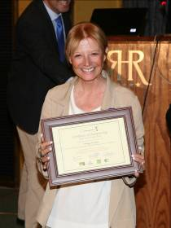
Parliamentary Leadership
US Senate Resolution supporting regional effort to rehabilitate the Jordan River passed unanimously November 2007
EU Parliament Resolution 2010
Israeli Knesset Hearings 2010, 2011 & 2012
Jordan Parliament Hearing 2011

Slide 16
















Media Attention

Slide 17
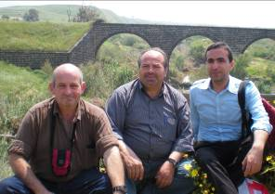
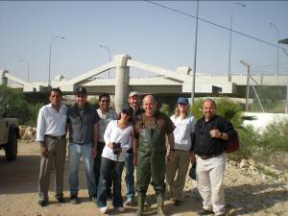
Regional Studies on the State of the Environment of the Lower Jordan River
Environmental Flow
Economic Analysis of policy options for water conservation
Economic Benefits study
Regional Advisory Committee

Slide 18
Allocation estimates needed by each country to meet rehabilitation goal
Two criteria were utilized to estimate the allocations needed by country to meet the rehabilitation goal:
1) Amount Diverted by each Country
2) Socio-Economic considerations
Regional Advisory Committee

Slide 19
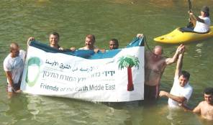
FoEME Regional Rehabilitation Goal
400-600 mcm annually, one minor flood
Salinity level less than 750 ppm; primarily fresh water with only the highest quality of effluents allowed up to 25% of the LJR's base flow
This strategy would remove most of the disturbances, restore the river's structure and function, allow biodiversity to recover and achieve a fair to high ecosystem integrity and health.
Regional Advisory Committee

Slide 20
Average Annual Flows Diverted by Each Country
Israel: 46.47%
Syria: 25.24%
Jordan: 23.24%
Palestine: 5.05%
These figures are based on a 1953 survey of Jordan River streams + Allocations decided upon in the 1994 Jordanian-Israeli Peace Treaty

Slide 21
Amounts required by each country to meet annual rehabilitation goal
To implement a rehabilitation strategy requiring at least 400 mcm per year, the following quantities would be needed annually:
Israel – 220 mcm (54%)
Syria – 100 mcm (24%)
Jordan – 90 mcm (22%)
Palestine would not be asked to contribute water
rather it needs to receive riparian share of the
Jordan River.

Slide 22


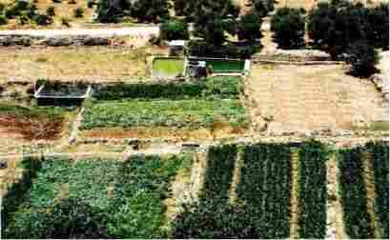
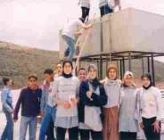
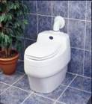

Study: Where Could the Water Come From?
Supply Side: rainwater catchment, reduction in evaporation, leakage, wastewater reclamation in agriculture
Demand Side: awareness raising, domestic demand management, grey water use, pricing reform in domestic and agriculture sectors, removal of trade restrictions, improved irrigation efficiency

Slide 23
Economic Study Conclusions
914 million cubic meters of water can be saved/produced in Israel, Jordan and Palestine at less than the marginal cost of water.
Part of which, from Israel and Jordan, can be utilized to meet the rehabilitation goal for the Lower Jordan River.
Economic Benefit Study shows that rehabilitation makes economic and environmental sense.

Slide 24
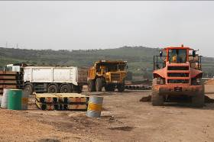
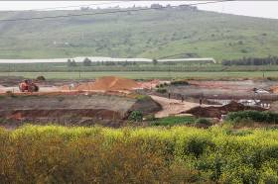
Achievements
Governments are Removing Sewage!
Construction of new sewage treatment plants in Israel, Jordan and Palestine will remove sewage waters currently discharged into LJR and improve water quality.

Slide 25
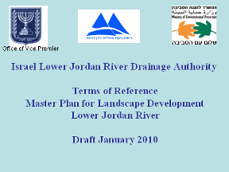
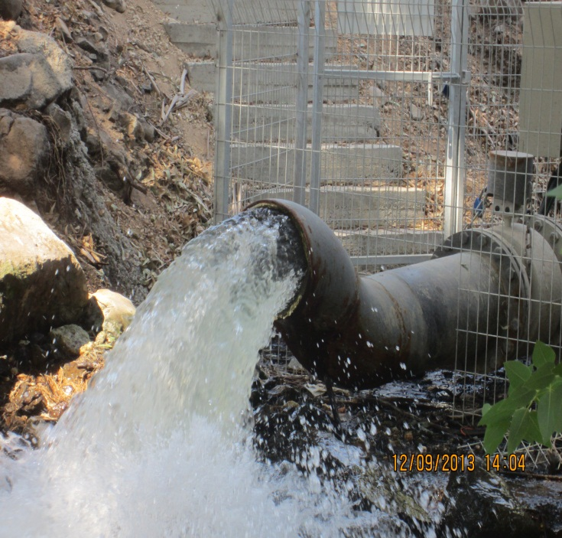
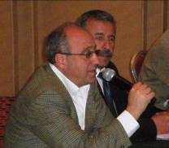
Achievements
Israeli Government initiates Master Plan for rehabilitation from the Sea of Galilee to Bezeq stream
Israeli Commitment of 30 mcm
Israeli Draft Cabinet Resolution that Rehabilitation of River be National Priority Project
Notes:
Israel committed to 30 MCM by next year and since May 2013 prepared the infrastructure and started releasing 9MCM from the Sea of Galilee

Slide 26

Master Planning
To create a regional FoEME master plan for the Lower Jordan River
Based on harmonizing national master plans into a single cohesive FoEME Transboundary Master Plan.
Underlying principles: Sustainability, Equity, Shared Benefits

Slide 27

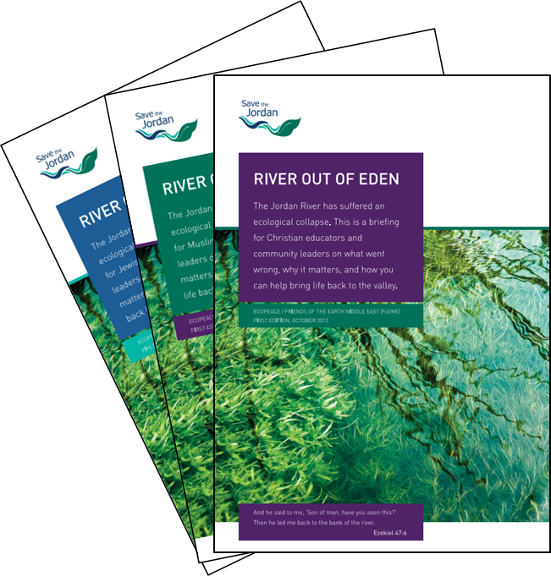
Launched Nov 2013 Faith based Campaign
Rehabilitation of the Jordan River: A commitment of Faith

Slide 28
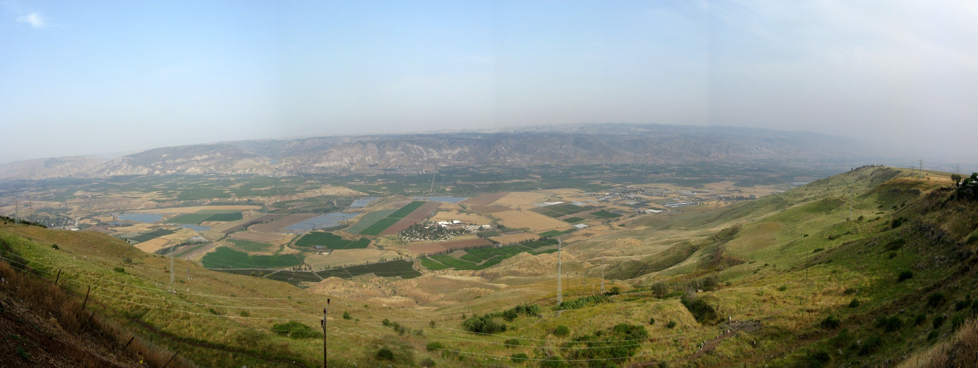
Together we can bring Peace & Prosperity to the peoples of the Lower Jordan River!
For more information visit www.foeme.org

